Slide 1


FoodPlanner.AI
Your Fridge, Planned!
A spoilage-aware, diet-safe AI meal planner that turns pantry photos into multi-day meal trajectories with zero food waste.
Dhanashree Nerkar
Fenil Vaghasiya
Zeren Xiao

Slide 2




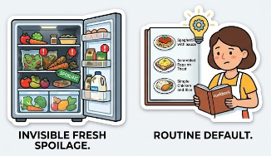
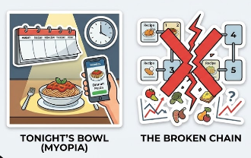
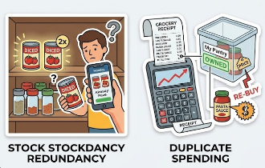
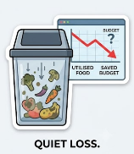
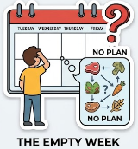
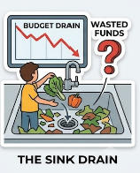
The Broken Status Quo: 3 Key Market Problems
FoodPlanner.AI
1. Invisible Fresh Spoilage
2. Single-Meal Myopia
3. Financial & Food Leakage
Food quietly spoils in back shelves while cooks default to the same 3-4 simple meals day after day.
Traditional recipe apps answer "what can I cook now?" for 1 dish, completely failing multi-day trajectories.
Home cooks repeatedly re-buy groceries they already own, inflating weekly grocery budgets needlessly.
Northeastern University • INFO 7375
Slide 2

Slide 3



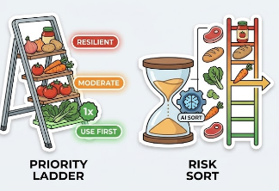
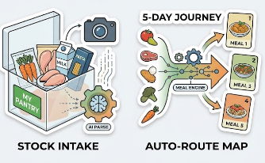
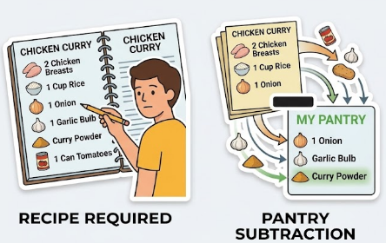
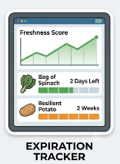

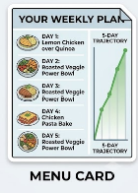
The FoodPlanner.AI Fix: Smart Core Engines
FoodPlanner.AI
1. Shelf-Life Engine
2. Multi-Day Trajectory
3. Subtract-Only Math
Ranks pantry items by expiration urgency, prioritizing high-risk items (score ≥ 4) for immediate use.
Transforms stock into a 5-day automated meal journey that spans multiple dishes seamlessly.
Calculates (Required Recipe Items - Owned Inventory) to generate exact gap-only store receipts.
Northeastern University • INFO 7375
Slide 3

Slide 4



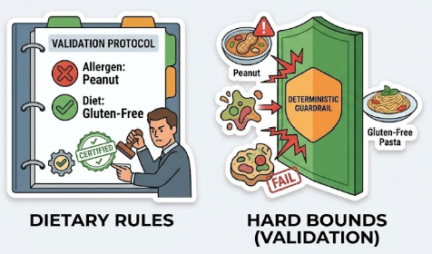
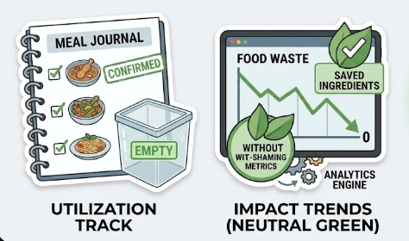
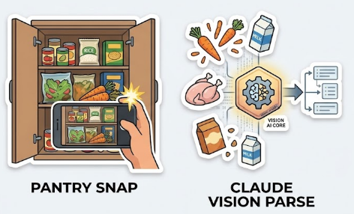
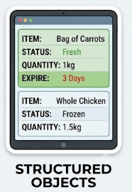
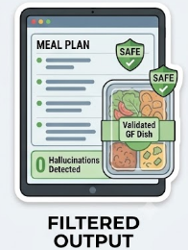

FoodPlanner.AI
Core Platform Features: Vision, Safety & Analytics
1. Vision AI Intake
2. Deterministic Safety Net
3. Waste Analytics
Claude Vision processes fridge photos directly into structured, machine-readable JSON inventory objects.
Hardcoded Python validators enforce dietary boundaries with 0% LLM hallucination risk.
Tracks confirmed utilization and spoilage events with buy-less guidance—strictly avoiding money guilt.
Northeastern University • INFO 7375
Slide 4

Slide 5
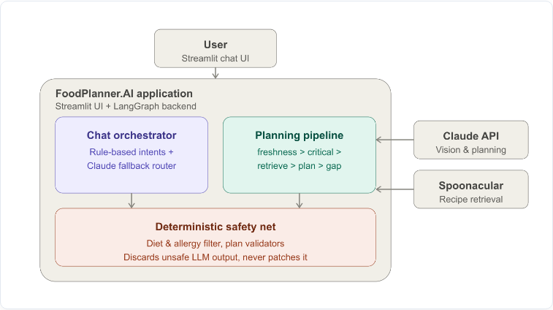



End-to-End System Architecture
FoodPlanner.AI
Streamlit Orchestrator
Classifies user intent using rule-based filters backed by Claude NLU fallback.
LangGraph Pipeline
Sequences execution: Freshness > Critical > Recipe Retrieval > Trajectory Plan > Gap Math.
Deterministic Safety Net
Python code blocks unsafe outputs outright rather than patching hallucinated text.
Northeastern University • INFO 7375
Slide 5

Slide 6
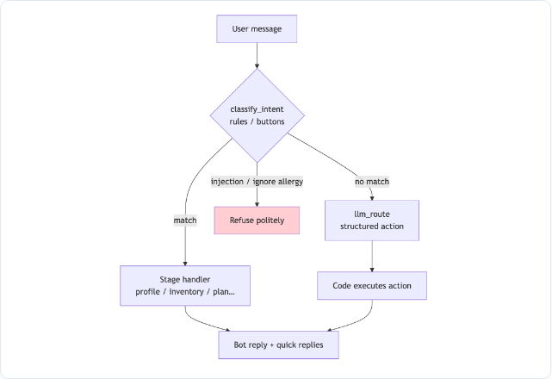



Chat Orchestration & Intent Routing
FoodPlanner.AI
Rule-Based Fast Path
Standard commands match deterministic rules instantly, eliminating unnecessary LLM latency.
Active Jailbreak Guard
Detects prompt injection attempts (e.g., 'ignore allergy rules') and politely refuses before hitting LLM context.
Structured NLU Fallback
Unmatched messages route to Claude, returning structured JSON actions to execute backend code.
Northeastern University • INFO 7375
Slide 6

Slide 7
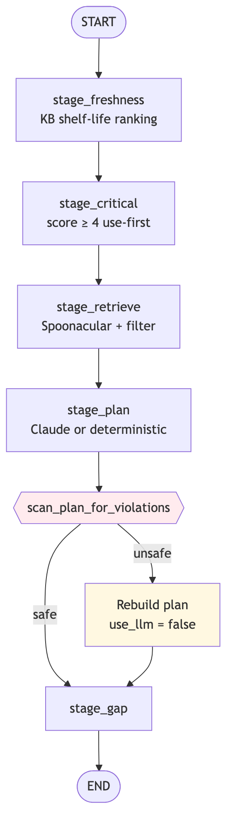



LangGraph Multi-Agent Execution Machine
FoodPlanner.AI
1. Freshness & Critical Priority
Evaluates shelf life knowledge base; flags items with score ≥ 4 as priority recipe constraints.
2. Spoonacular Recipe Retrieval
Queries Spoonacular API prioritizing at-risk inventory while applying active diet filters.
3. Deterministic Fallback Loop
If scan_plan_for_violations detects an unsafe item, it triggers use_llm = false and rebuilds deterministically.
Northeastern University • INFO 7375
Slide 7

Slide 8
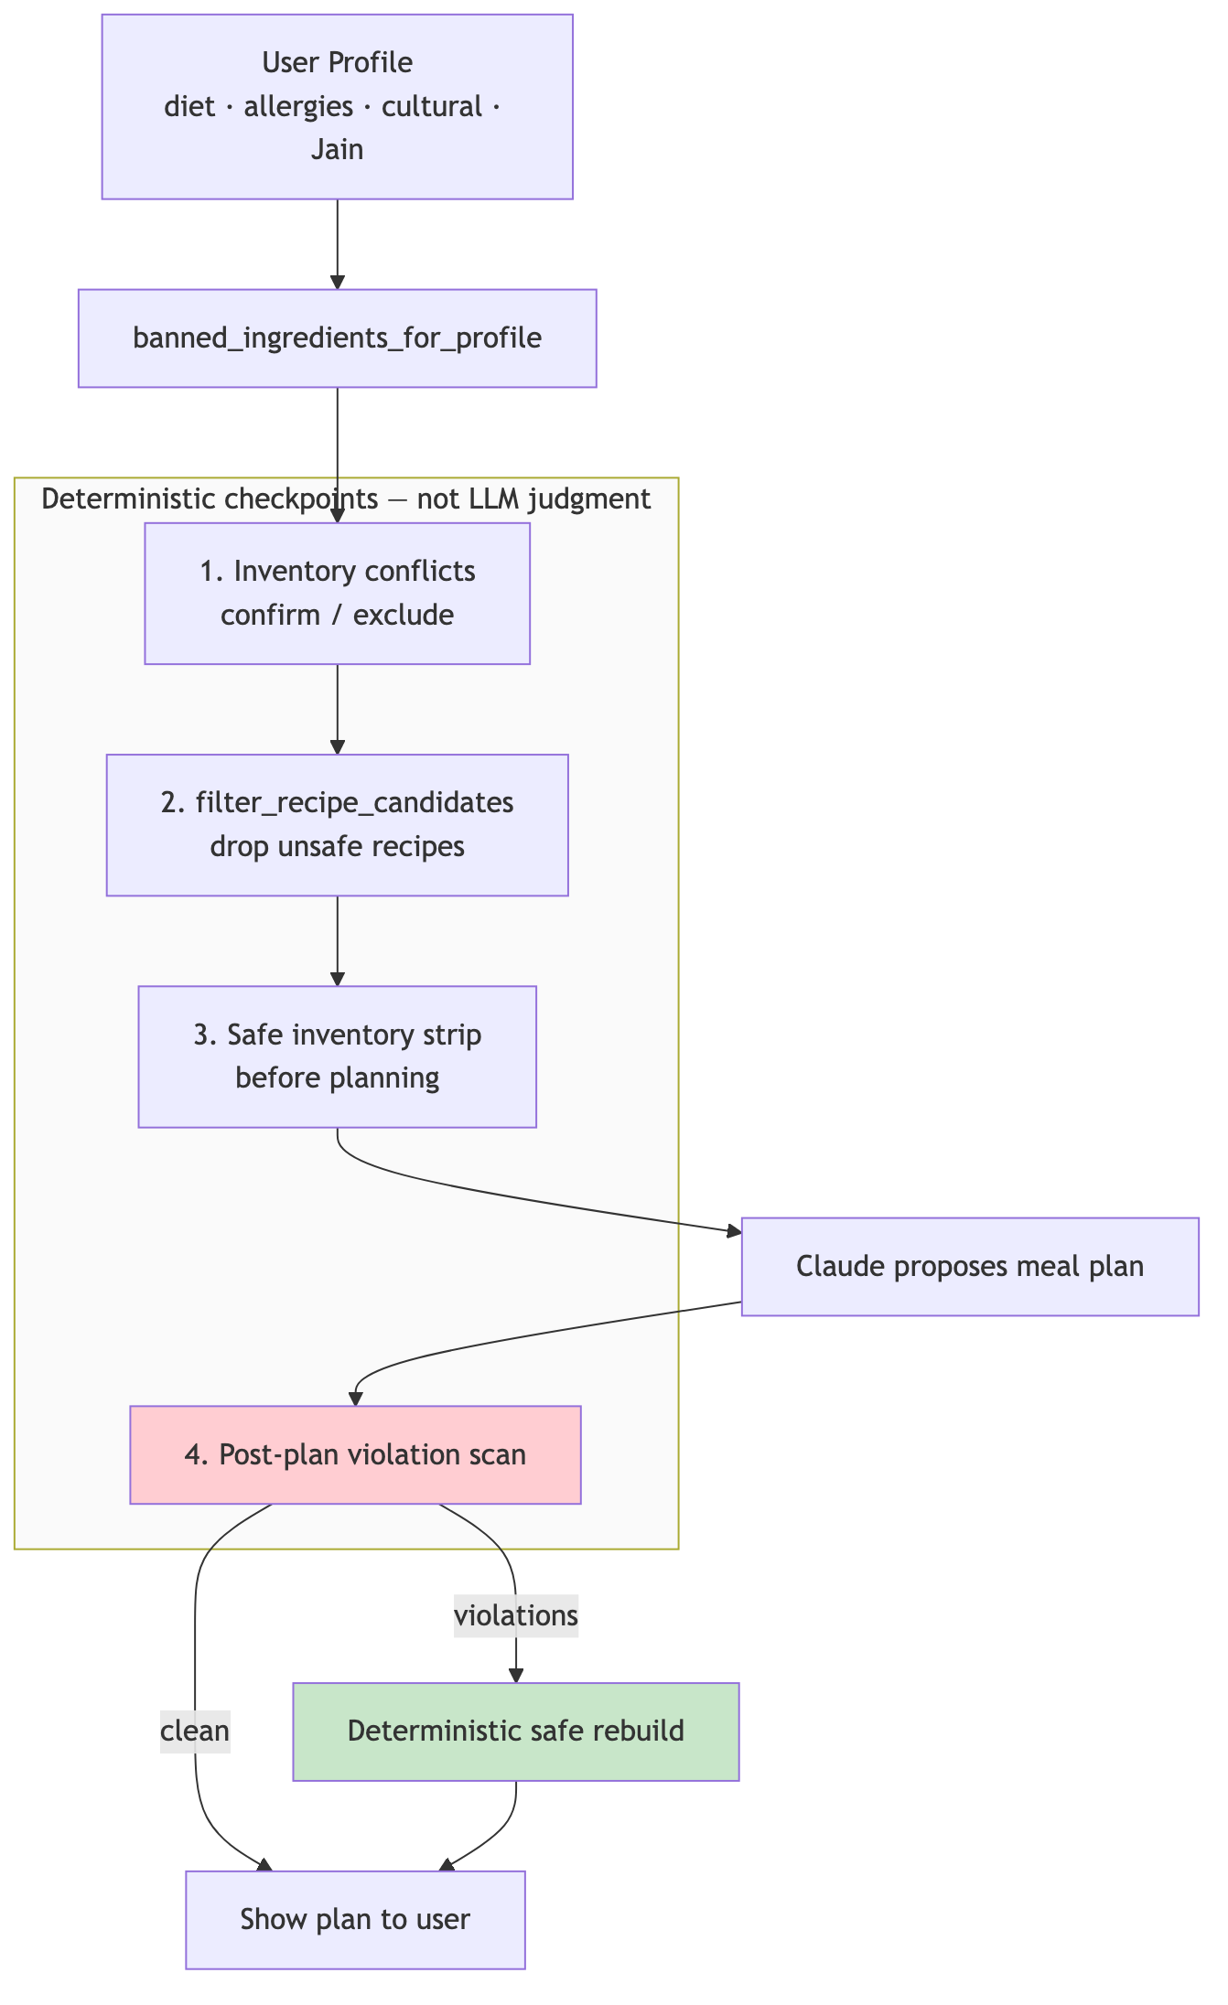



FoodPlanner.AI
Deterministic Safety & Dietary Guardrails
Rule-Based Checkpoints
Safety is never left to LLM judgment. Python code enforces inventory stripping, candidate filtering, and post-plan violation scans.
Strict JSON Schemas & Trap Nudges
Constrains Claude outputs to structured JSON and includes in-context nudges for hidden traps (gelatin in desserts, fish sauce in curries).
Zero-Tolerance Discard
Unsafe model responses are completely dropped and re-routed via deterministic safe rebuilds targeting 0% constraint violations.
Northeastern University • INFO 7375
Slide 8

Slide 9
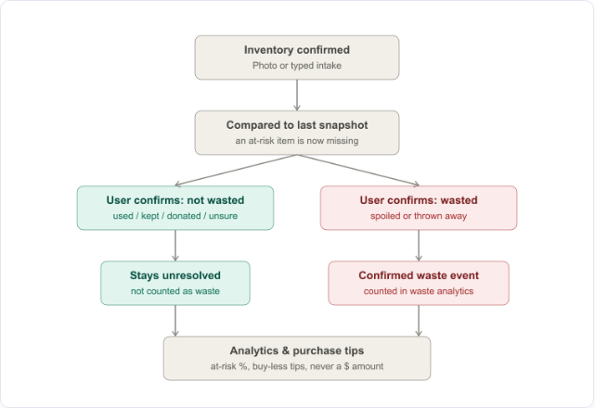


Waste Analytics & Differential Tracking
FoodPlanner.AI
Snapshot Differential
Compares newly confirmed inventory against previous snapshots to flag missing at-risk ingredients automatically.
Non-Wasted Confirmation
Items marked as used, kept, donated, or unsure remain neutral and are excluded from waste statistics.
Judgement-Free Analytics
Confirmed spoilage feeds into buy-less guidance and at-risk %, strictly avoiding dollar shaming or money guilt.
Northeastern University • INFO 7375
Slide 9

Slide 10





FoodPlanner.AI
Testing Rigor & Future Scaling
Testing Rigor & Metrics
Roadmap & Scaling Scope
48
0%
100%
Managed Infrastructure:
Migrating local JSON storage to PostgreSQL with Row-Level Security (RLS) for multi-tenant users.
Unit Tests
Diet Violations
Workflow Coverage
Perceptual Image Hashing:
Continuous integration verifies diet safety filters, gap-list subtraction math, waste tracking logic, and chat intent routing.
Upgrading exact-byte photo matching to perceptual hashing to recognize near-duplicate fridge photos across lighting changes.
Expanded Religious Diets:
Broader Halal and Kosher substitution rulesets with USDA database enrichment.
Northeastern University • INFO 7375
Slide 10

Slide 11









Real-World Conversational Scenarios
Jain Diet Request
Allergy Interception
Pantry Derivation

Slide 12


Roadmap & Future Scaling
Local Storage Scope: Local JSON storage (great for demo testing, scaling to multi-tenant DB).
Managed Infrastructure: PostgreSQL database with Row-Level Security (RLS) for multi-tenant users.
Photo Deduplication: Photo matching is currently exact-byte only - adding perceptual hashing next.
Perceptual Image Hashing: Recognize near-duplicate fridge photos across lighting changes.
Cultural Substitution Depth: Expanding non-Western ingredient catalog for deeper Halal & Kosher support.
Expanded Religious Diets: Broader Halal and Kosher substitution rulesets and USDA enrichment.

Slide 13



Thank You!
Turning pantry photos into diet-safe, zero-waste meal plans you can trust every single night.

